Slide 1
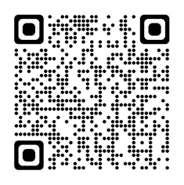
Staff Experience Week
We didn’t forget about you remote workers.
Starting Monday August 1st, you will be able to sign up to be entered into an exclusive remote worker drawing.
Gift basket valued at $50 and will be mailed to you.

Slide 2
Staff Experience Week
We didn’t forget about you remote workers.
Starting Monday August 1st, you will be able to sign up to be entered into an exclusive remote worker drawing.
Gift basket valued at $50 and will be mailed to you.

Slide 3
Please send your name, phone number and Mayo Clinic email address to
MCHospGiftShops@mayo.edu
You can also follow us on our Mayo Clinic Connect page for special’s through out the week.

